Slide 1



Stock Market Prediction Using Machine Learning

Slide 2
Project Members
MRIGANKA DAS Roll No.: 2400118050 Regn. No.: 182410110144 OF 2018-19
PADALA NITISH KUMAR Roll No.: 2400118034 Regn. No.: 182410110116 OF 2018-19
SUCHITA PAUL Roll No.: 2400118015 Regn. No.: 182410110135 OF 2018-19
SOMDUTTA PAUL Roll No.: 2400118020 Regn. No.: 182410110130 OF 2018-19
RAJDIP PAL Roll No.: 2400118029 Regn. No.: 182410110121 OF 2018-19

Slide 3
Project Mentor
Prof. Kishore Ghosh
Department of Computer Science and Engineering
Swami Vivekananda Institute of Science and Technology

Slide 4
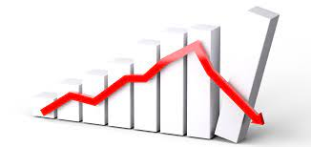
Introduction
.
Stock Market Prediction is all about prediction of future trend of the various stock tickers based on their past data.
The stock market is considered to be very dynamic and complex in nature.
The deep learning models are being used nowadays which have proven their advantage over traditional machine learning methods in terms of accuracy and speed of prediction.
In this project, we will use the Long-Short-Term Memory (LSTM) Recurrent Neural Network, one of the popular deep learning models, used in stock market prediction.

Slide 5
Motivation and Objective
In today’s world, stock market can be the best option for the investment if we invest in it with proper planning.
Helps create personal wealth.
Investment in Stock Market is now becoming more relevant in this covid-19 and lockdown era when people are losing their job or working from home.

Slide 6
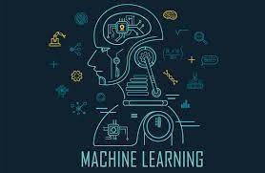
Machine Learning- a solution
The stock market is considered to be very dynamic and complex in nature.
Predicting stock prices is an uncertain task which is modelled using machine learning to predict the return on stocks.
Over the years, various machine learning techniques have been used in stock market prediction, but with the increased amount of data and expectation of more accurate prediction.
the deep learning models are being used nowadays which have proven their advantage over traditional machine learning methods in terms of accuracy and speed of prediction.
In this project, we will use the Long-Short-Term Memory (LSTM) Recurrent Neural Network, one of the popular deep learning models, used in stock market prediction.

Slide 7
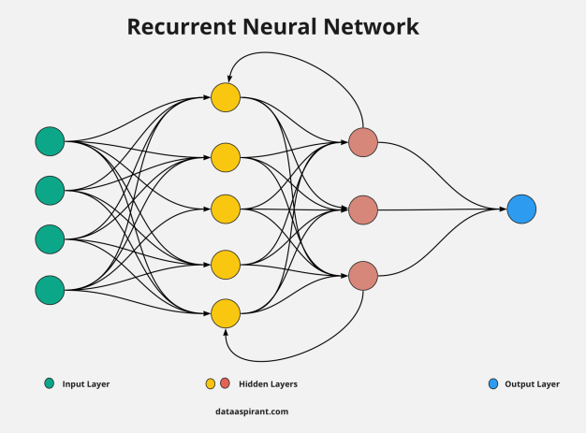
RNN
Recurrent Neural Network(RNN) are a type of Neural Network where the output from previous step are fed as input to the current step.

Slide 8
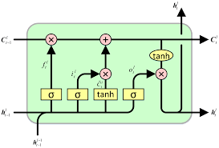
LSTM
Long-Short-Term Memory Recurrent Neural Network belongs to the family of deep learning algorithms.
It is a recurrent network because of the feedback connections in its architecture.
It has an advantage over traditional neural networks due to its capability to process the entire sequence of data.
Its architecture comprises the cell, input gate, output gate and forget gate.
The cell remembers values over arbitrary time intervals, and the three gates regulate the flow of information into and out of the cell.

Slide 9
LSTM
The cell of the model is responsible for keeping track of the dependencies between the elements in the input sequence.
The cell of the model is responsible for keeping track of the dependencies between the elements in the input sequence.
The input gate controls the extent to which a new value flows into the cell, the forget gate controls the extent to which a value remains in the cell, and the output gate controls the extent to which the value in the cell is used to compute the output activation of the LSTM unit.
LSTM Networks are popularly used on time-series data for classification, processing, and making predictions.

Slide 10
Model Training
In this project, we will use the Long Short-Term Memory (LSTM) Recurrent Neural Network, one of the popular deep learning models, used in stock market prediction.
Model Training Steps:
Load the data
2. Pre-process the data in order to prepare it for the LSTM model.
3. Define the LSTM Recurrent Neural Network. Here, we can add more LSTM layers and adjust the dropout in order to improve the accuracy of the model.
4. Compile and train the model defined in the above step. Iteratively, we can increase or decrease the epochs and batch size to get more accuracy.
5. Now, our model is trained.

Slide 11
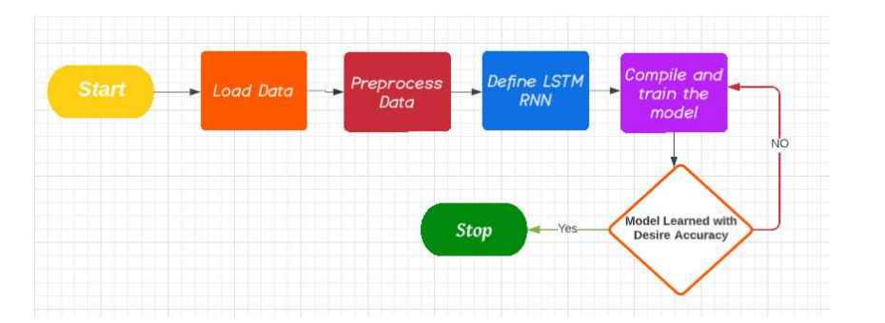
Fig. : Flow Chart for Model Training

Slide 12
Prediction
Prediction Steps:
Load the data
Pre-process the data
Load the LSTM model
Predict the values
Plot the predicted values

Slide 13
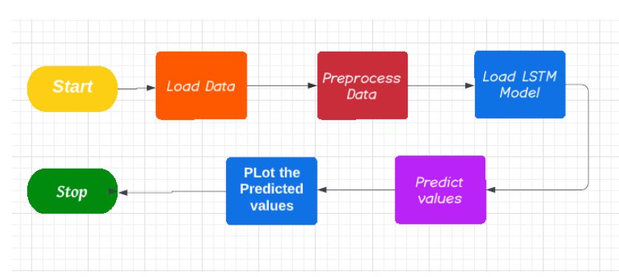
Fig. : Flow Chart for Prediction

Slide 14

PYTHON- as a tool
Library | Used for
pandas | Data analysis and manipulation
numpy | Numerical operation on arrays
matplotlib | Data visualization
streamlit | Web View Development
tensorflow | Model Training

Slide 15
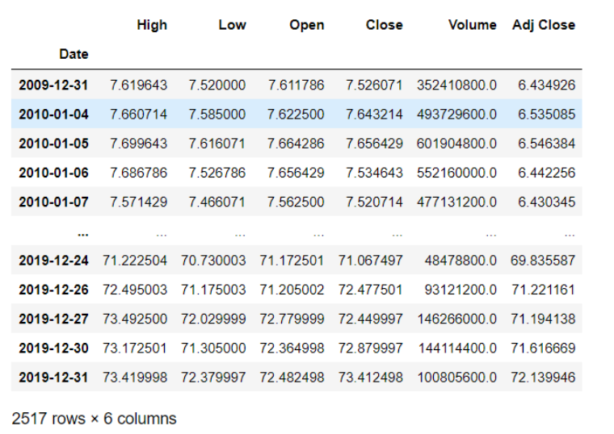
Illustration
The historical prices of AAPL are collected automatically using the pandas_datareader of python. We have used 10 years of historical price data, from 01.01.2010 to 31.12.2018.

Slide 16
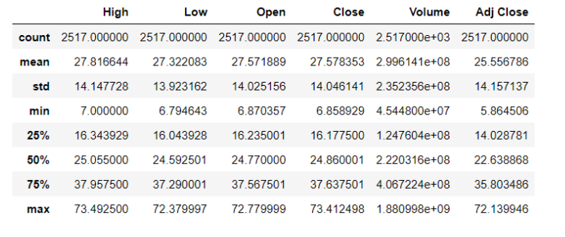
Before Processing the data, we need to understand and visualize the it to get a sense of what the data entails as well as the identification of features that will be important to us.
Table : Description of Stock Data of AAPL from 2010-01-01 to 2019-12-31

Slide 17
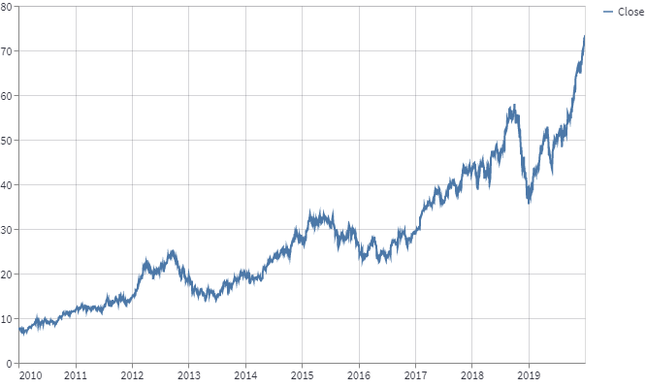
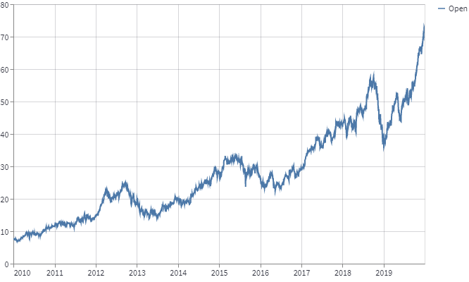
Visualization of Data:
Fig. : Close vs Time Plot
Fig. : Open vs Time Plot

Slide 18
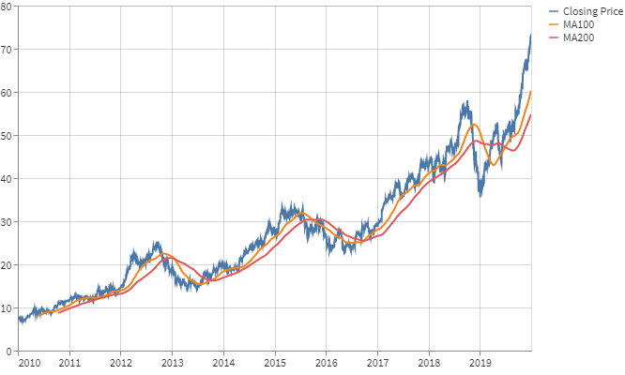
Fig : (Close, MA100, MA200) vs Time Plot

Slide 19
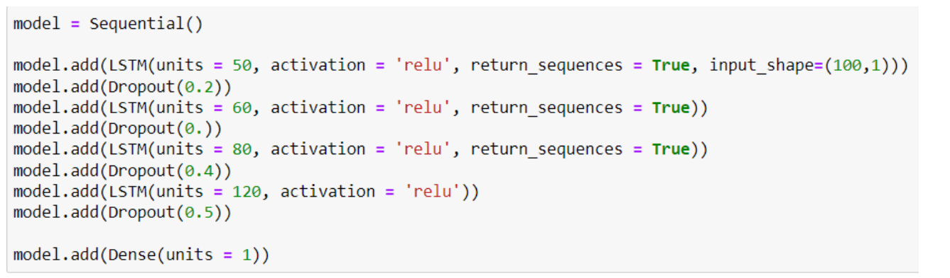
We Pre-process the data in order to prepare it for the LSTM model.
Then, we split the dataset into training and testing set. We use 70% data for training and 30% for testing.
Define the LSTM Recurrent Neural Network. Here, you can add more LSTM layers and adjust the dropout in order to improve the accuracy of the model.
Fig. : Code snippet for Defining LSTM RNN

Slide 20
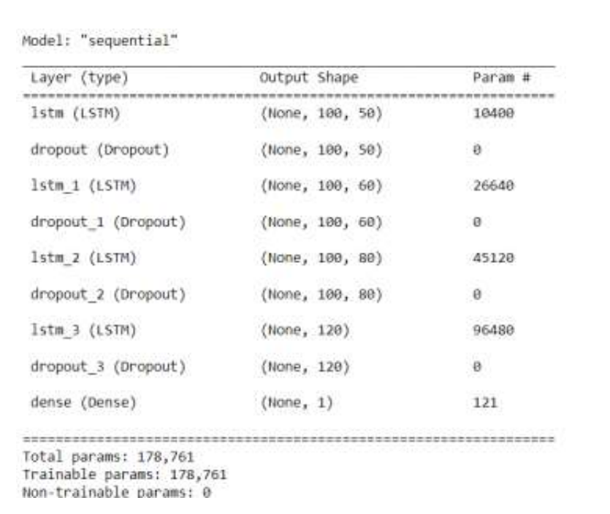
Fig.: Summary of LSTM model

Slide 21
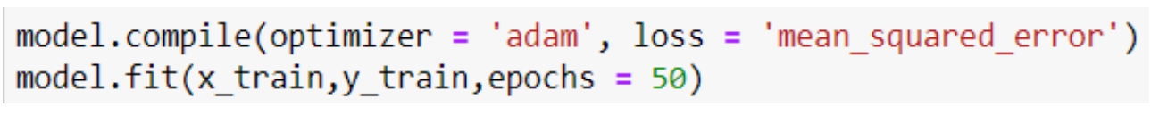
Next, Compile and train the model defined in the above step. Iteratively, we can increase or decrease the epochs and batch size to get more accuracy.
Fig : Code Snippet for compiling model
Now, our model is trained and needs to be tested on the testing data.

Slide 22
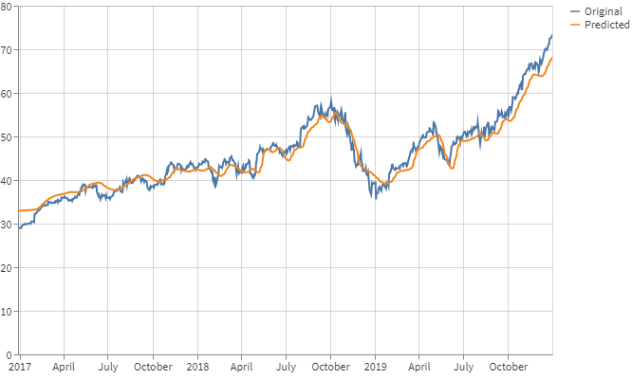
Lastly, we visualize the predicted stock prices with original stock prices.
Fig.: predicted stock prices with original stock prices

Slide 23
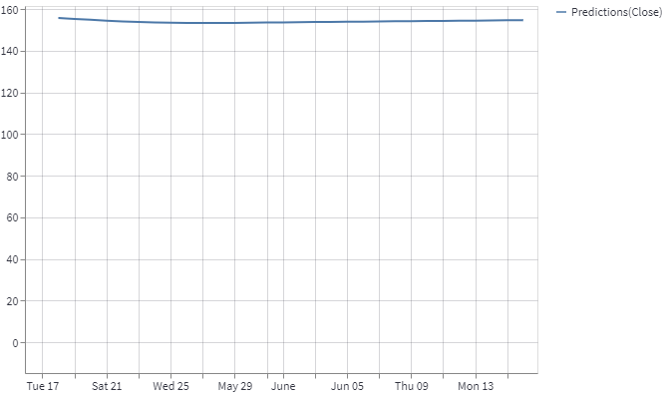
We can also predict the price of the stock for upcoming days. Here we have predicted AAPL stock price for next 30 days.
Fig.: Future Prediction vs Time Plot

Slide 24
Conclusion
LSTM model for stock prediction has been trained using AAPL stock data from 01.01.2010 to 31.12.2018.
We have used 4 hidden layers in LSTM model and ‘relu’ activation function of neurons.
The loss function was ‘meansquared-error’ and we have used ‘adam’ optimizer.
We have tested our model on different data set of various stock-tickers and over different period of time.
The performance of our model is quite good.
We have integrated this model with a web-application so that the user can easily get access to our model.

Slide 25
References
[1] Deep Learning Mooc by IIT Madras, NPTEL https://www.youtube.com/watch?v=aPfkYu_qiF4&list=PLyqSpQzTE6M9gCgajvQbc68Hk_ JKGBAYT
[2] Article on Hands-On Guide To LSTM Recurrent Neural Network For Stock Market Prediction https://analyticsindiamag.com/hands-on-guide-to-lstm-recurrent-neural-network-for-stockmarket-prediction/ [3] Analysis of Stock Price Predictions using LSTM models by Yu Hao Lee https://medium.com/analytics-vidhya/analysis-of-stock-price-predictions-using-lstm-modelsf993faa524c4
[4] Goodfellow, I., Bengio,Y., and Courville, A., Deep Learning, MIT Press, 2016.
[5] Bishop, C.M., Pattern Recognition and Machine Learning, Springer, 2006.
[6] Yegnanarayana, B., Artificial Neural Networks PHI Learning Pvt. Ltd, 2009.
[7] Golub, G.H. and Van Loan,C.,F., Matrix Computations, JHU Press,2013.
[8] Satish Kumar, Neural Networks: A Classroom Approach, Tata McGraw-Hill Education, 2004
[9] What is LSTM? By IBM Technology https://www.youtube.com/watch?v=b61DPVFX03I
[10] Simple Explanation of LSTM by Codebasics https://www.youtube.com/watch?v=LfnrRPFhkuY&t=5s
[11] Optimizing LSTM for time series prediction in Indian stock market by Anita Yadava, C K Jha, Aditi Sharan

Slide 26
THANK YOU !!!

